Slide 1
Library Management system
Festus Iipito #986683
Amjad Karim #986758
Francis Nahimana # 986635

Slide 2
OUTLINE
Use Case
Class Diagrams
Sequence Diagrams for main use cases
System Demonstration

Slide 3
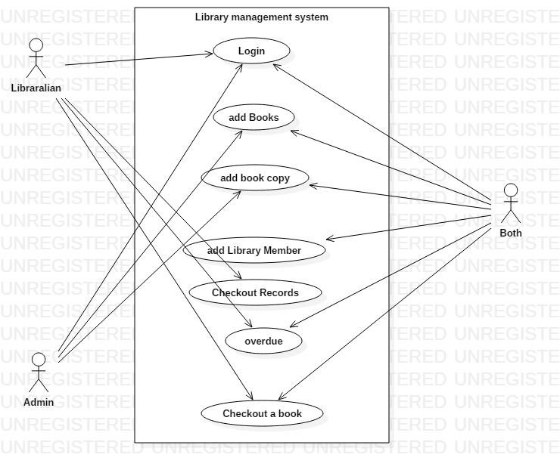
USE CASES
Login use case main flow
User Action | System Response
User fills the login form | System confirms the ID and password against the users in the database and displays the dashboard with the options for the specific user
Checkout book use case main flow (both role)
User Action | System Response
User selects an option check out book on the Side menu | System responds with a form for checking out book
User fills the form with required details | System checks if the check ID exist in the system and if there is a copy available and then checks out the book to the member
Add book use case main flow (both role)
User Action | System Response
User selects and option add Book from side menu | System responds with list and add book form
User fills the form and clicks new (submits) | System responds with an updated list

Slide 4
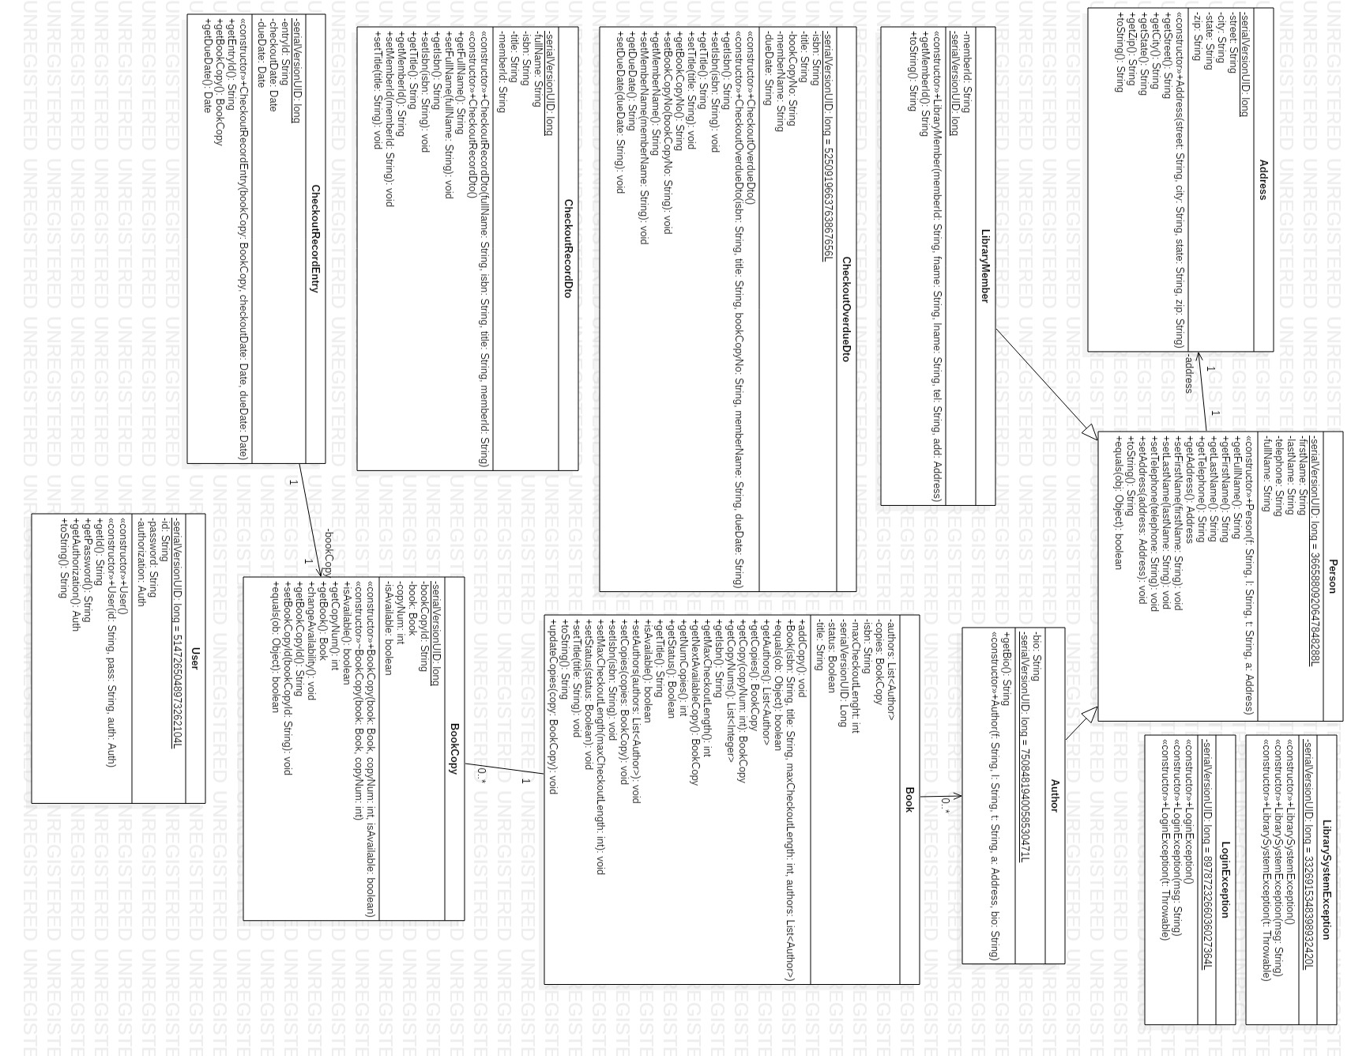
Class Diagrams

Slide 5
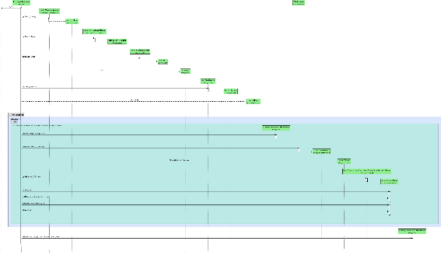
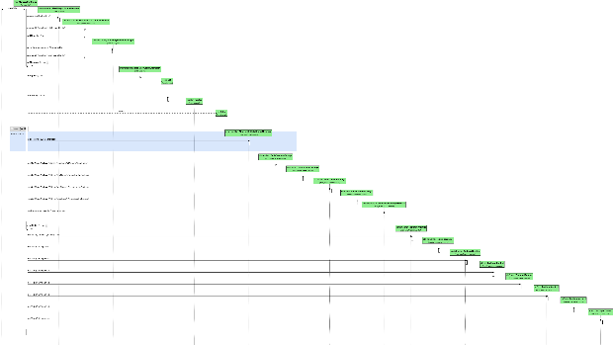
Sequence Diagrams for main use cases
Login
Add member

Slide 6
Demonstration
Lets switch to the system.

